Slide 1
Advanced Programming
CO2039
Chapter 5: Design Patterns
TP.HCM, 03/01/2025

Slide 2
CONTENT
01
02
03
04
05
INTRODUCTION TO DESIGN PATTERNS
CREATIONAL PATTERNS - SINGLETON
STRUCTURAL PATTERNS - ADAPTER
BEHAVIORAL PATTERNS - OBSERVER
CONCLUSION

Slide 3
01
INTRODUCTION TO DESIGN PATTERNS

Slide 4
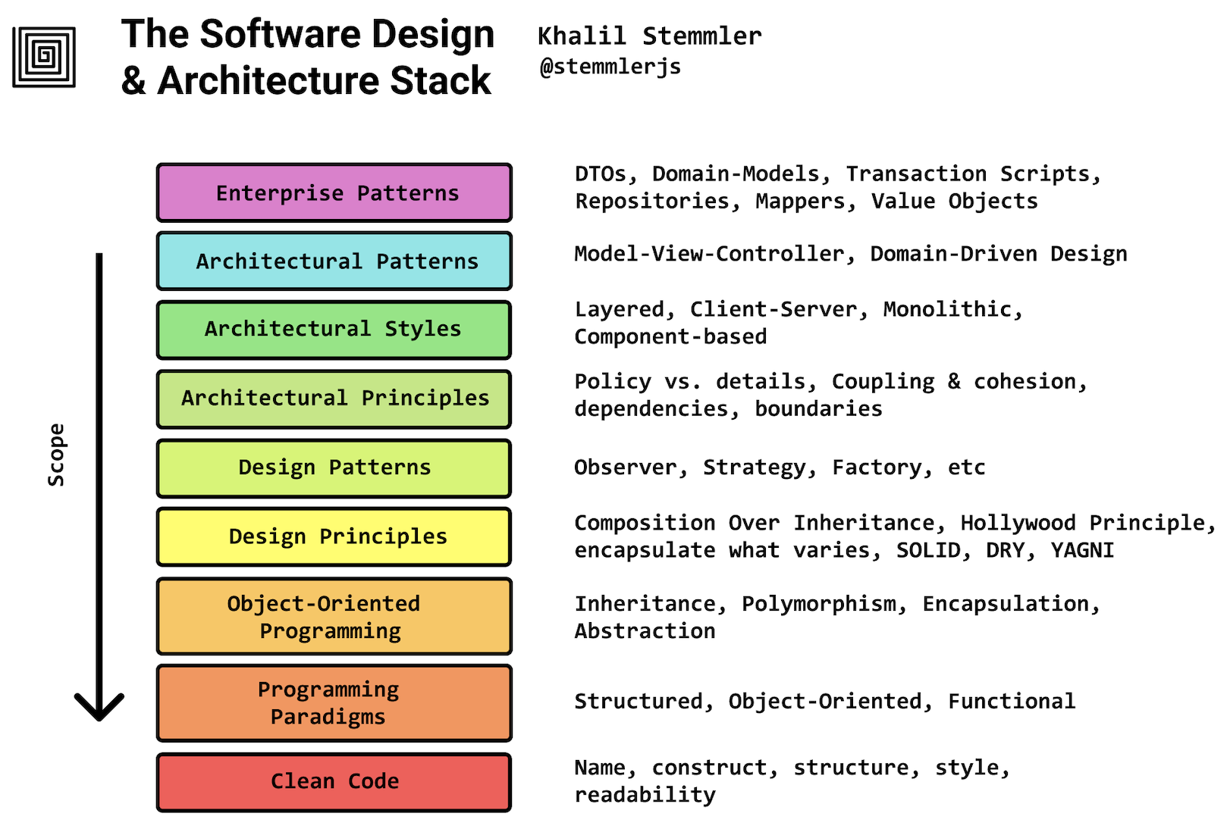
What is a design pattern?
Design patterns are typical solutions to commonly occurring problems in software design.
They are like pre-made blueprints that you can customize to solve a recurring design problem in your code.

Slide 5
Why should I learn patterns?
Design patterns are a toolkit of tried and tested solutions to common problems in software design. Even if you never encounter these problems, knowing patterns is still useful because it teaches you how to solve all sorts of problems using principles of object-oriented design.
Design patterns define a common language that you and your teammates can use to communicate more efficiently.
Good designers don't always start from scratch to solve problems. They often use existing solutions!

Slide 6
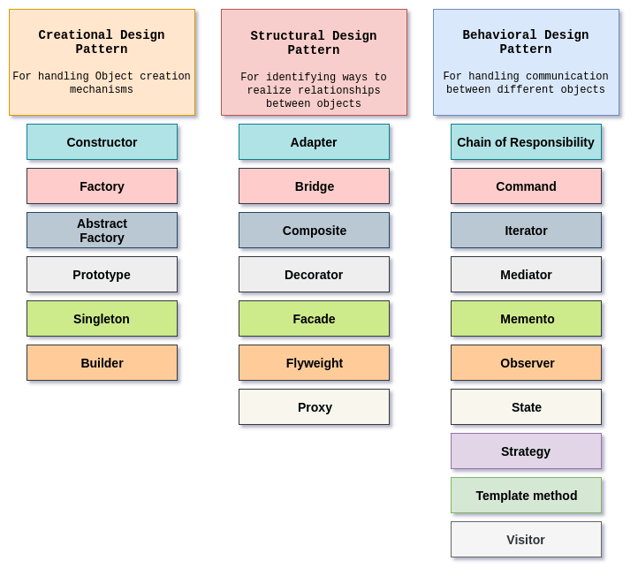
Organization

Slide 7
02
CREATIONAL PATTERNS - SINGLETON

Slide 8
What is Singleton?
Singleton is a creational design pattern that lets you ensure that a class has only one instance, while providing a global access point to this instance.
WHY? Solve 2 problems violating Single Responsibility Principle:
Ensure a single instance
Prevent multiple instances of a class.
Control access to shared resources (e.g., database, files).
Provide global access
Act like a global variable but prevent accidental overwrites.
Centralize instance management within one class.

Slide 9
Implementation
All implementations of the Singleton have these two steps in common:
Make the default constructor private, to prevent other objects from using the new operator with the Singleton class.
Create a static creation method that acts as a constructor. Under the hood, this method calls the private constructor to create an object and saves it in a static field. All following calls to this method return the cached object.

Slide 10
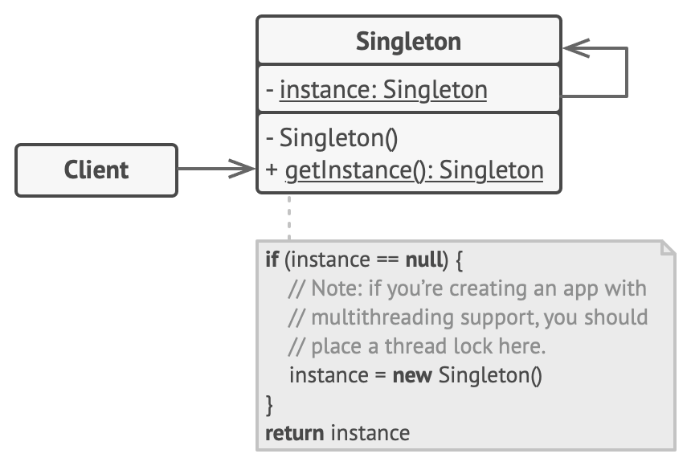
Structure
Notes:
The Singleton class declares the static method getInstance that returns the same instance of its own class.
The Singleton’s constructor should be hidden from the client code. Calling the getInstance method should be the only way of getting the Singleton object.

Slide 11
Step-by-step instructions
Add a private static field to the class for storing the singleton instance.
Declare a public static creation method for getting the singleton instance.
Implement “lazy initialization” inside the static method. It should create a new object on its first call and put it into the static field. The method should always return that instance on all subsequent calls.
Make the constructor of the class private. The static method of the class will still be able to call the constructor, but not the other objects.
Go over the client code and replace all direct calls to the singleton’s constructor with calls to its static creation method.

Slide 12
03
STRUCTURAL PATTERNS - ADAPTER

Slide 13
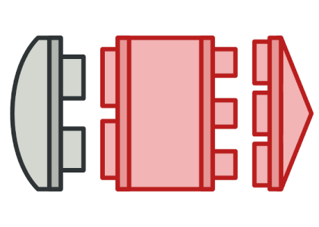
What is Adapter?
Adapter is a structural design pattern that allows objects with incompatible interfaces to collaborate.
WHY? Solve compatibility issue - bridge incompatible interfaces
Allow two incompatible classes to work together.
Convert one interface into another expected by the client.

Slide 14
Implementation
Hide complexity: Wrap an object to handle conversion behind the scenes.
Bridge interface: Allow incompatible objects to work together.
How it works:
Adapter provides an interface matching the client’s needs.
Client calls the adapter’s methods.
Adapter translates the request and forwards it to the target object.

Slide 15
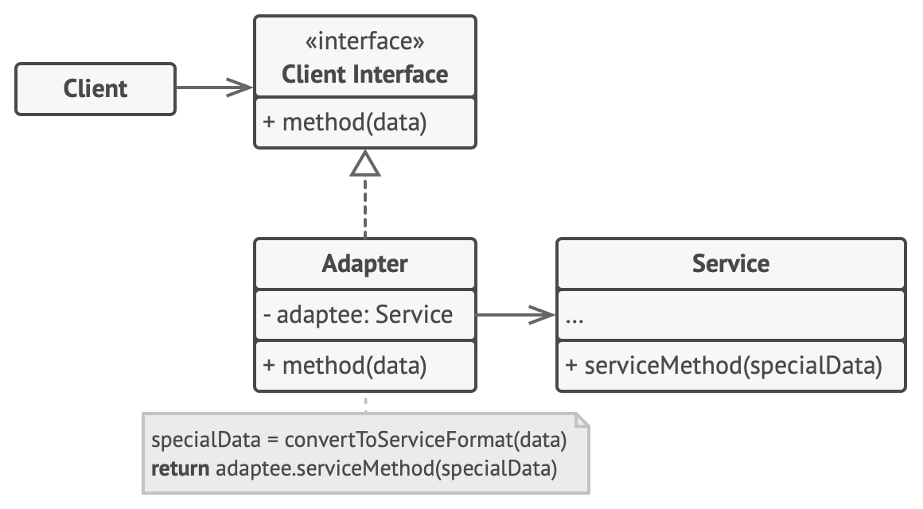
Structure - Object adapter
Notes:
The Client is a class that contains the existing business logic of the program.
The Client Interface describes a protocol that other classes must follow to be able to collaborate with the client code.
The Service is some useful class (usually 3rd-party or legacy). The client can’t use this class directly because it has an incompatible interface.
The Adapter is a class that’s able to work with both the client and the service: it implements the client interface, while wrapping the service object. The adapter receives calls from the client via the client interface and translates them into calls to the wrapped service object in a format it can understand.
The client code doesn’t get coupled to the concrete adapter class as long as it works with the adapter via the client interface. Thanks to this, you can introduce new types of adapters into the program without breaking the existing client code. This can be useful when the interface of the service class gets changed or replaced: you can just create a new adapter class without changing the client code.

Slide 16
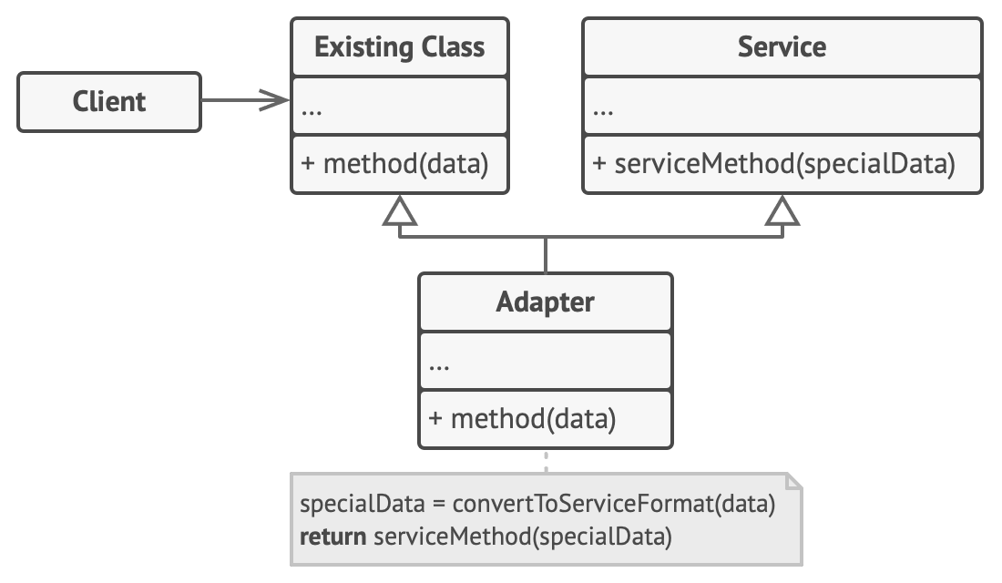
Structure - Class adapter
Notes:
This implementation uses inheritance: the adapter inherits interfaces from both objects at the same time. Note that this approach can only be implemented in programming languages that support multiple inheritance, such as C++.
The Class Adapter doesn’t need to wrap any objects because it inherits behaviors from both the client and the service. The adaptation happens within the overridden methods. The resulting adapter can be used in place of an existing client class.

Slide 17
Step-by-step instructions
Make sure that you have at least two classes with incompatible interfaces:
A useful service class, which you can’t change.
One or several client classes that would benefit from using the service class.
Declare the client interface and describe how clients communicate with the service.
Create the adapter class and make it follow the client interface. Leave all the methods empty for now.
Add a field to the adapter class to store a reference to the service object.
One by one, implement all methods of the client interface in the adapter class.
Clients should use the adapter via the client interface. This will let you change or extend the adapters without affecting the client code.

Slide 18
Example: Sensor problem
class TS7000 {
native double getTemp();
...
}
...
double sum = 0.0;
for (int i = 0; i < sensors.length; i++)
sum += sensors[i].getTemp();
double meanTemp = sum / sensors.length;
// New sensor device
class SuperTempReader {
// NOTE: temperature is Celsius tenths of a degree
native double current_reading();
...
}

Slide 19
Without adapter pattern
for (int i = 0; i < sensors.length; i++){
if (sensors[i] instanceof TS7000)
sum += ((TS7000)sensors[i]).getTemp();
else
// Must be a SuperTemp!
sum += ((SuperTempReader)sensors[i]).current_reading() * 10;
}

Slide 20
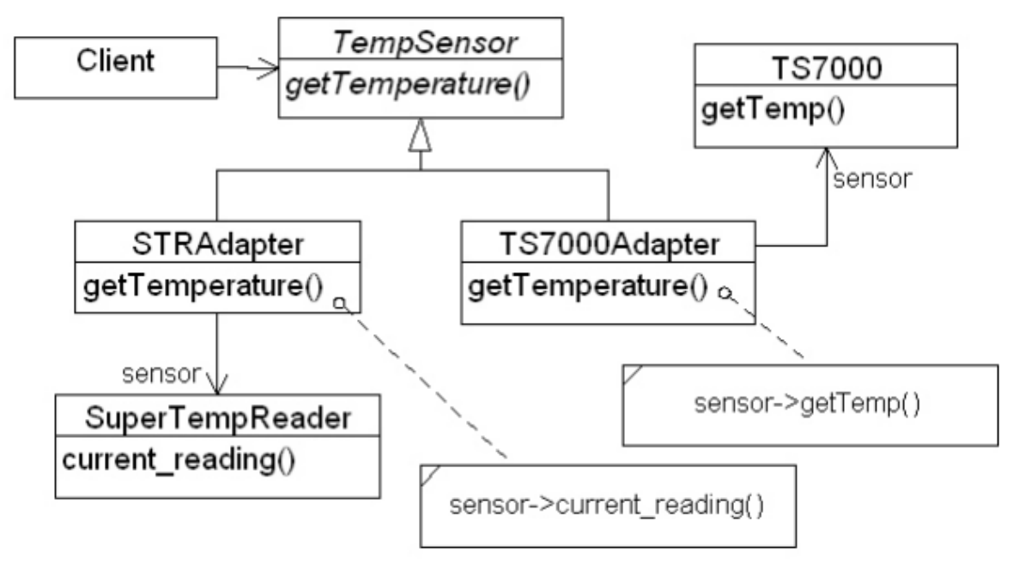
Adapter to the rescue (1)

Slide 21
Adapter to the rescue (2)
abstract class TempSensor{
abstract double getTemperature();
}
class STRAdapter extends TempSensor{
public double getTemperature(){
return sensor.current_reading() * 10;
}
}
class TS7000Adapter extends TempSensor{
public double getTemperature(){
return sensor.getTemp();
}
}
...
double sum = 0.0;
for (int i = 0; i < sensors.length; i++)
sum += sensors[i].getTemperature();

Slide 22
04
BEHAVIORAL PATTERNS - OBSERVER

Slide 23
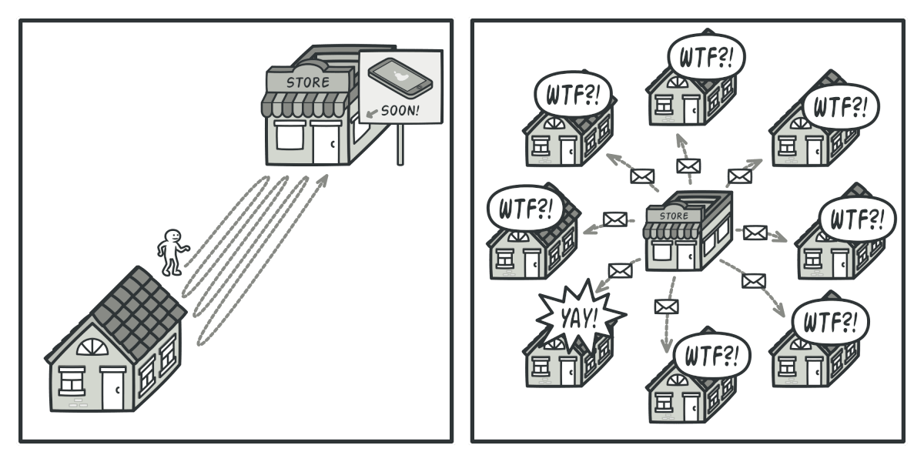
What is Observer?
Observer is a behavioral design pattern that lets you define a subscription mechanism to notify multiple objects about any events that happen to the object they’re observing.
Notes:
Imagine that you have two types of objects: a Customer and a Store. The customer is very interested in a particular brand of product (say, it’s a new model of the iPhone) which should become available in the store very soon.
The customer could visit the store every day and check product availability. But while the product is still en route, most of these trips would be pointless.
On the other hand, the store could send tons of emails (which might be considered spam) to all customers each time a new product becomes available. This would save some customers from endless trips to the store. At the same time, it’d upset other customers who aren’t interested in new products.
It looks like we’ve got a conflict. Either the customer wastes time checking product availability or the store wastes resources notifying the wrong customers.

Slide 24
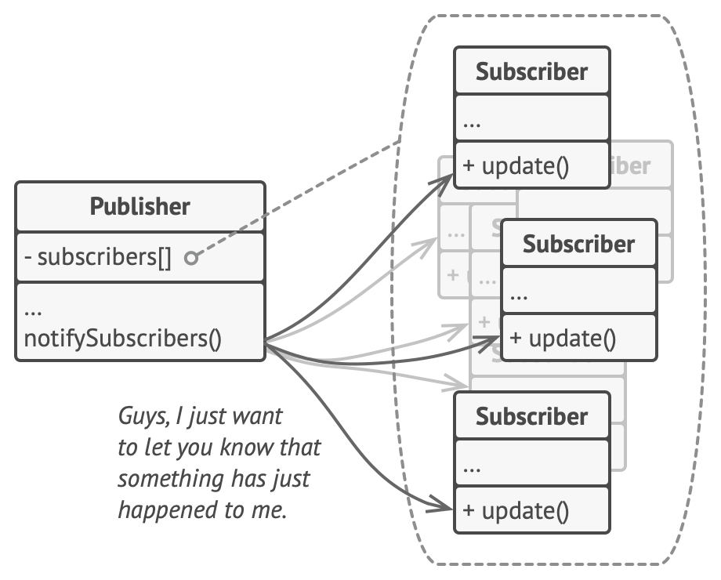
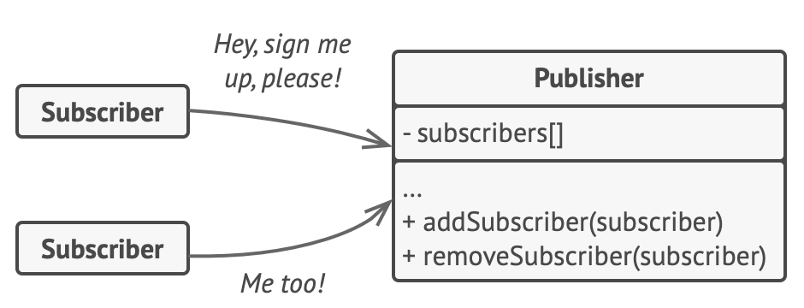
Implementation
A subscription mechanism lets individual objects subscribe to event notifications.
Publisher notifies subscribers by calling the specific notification method on their objects.

Slide 25
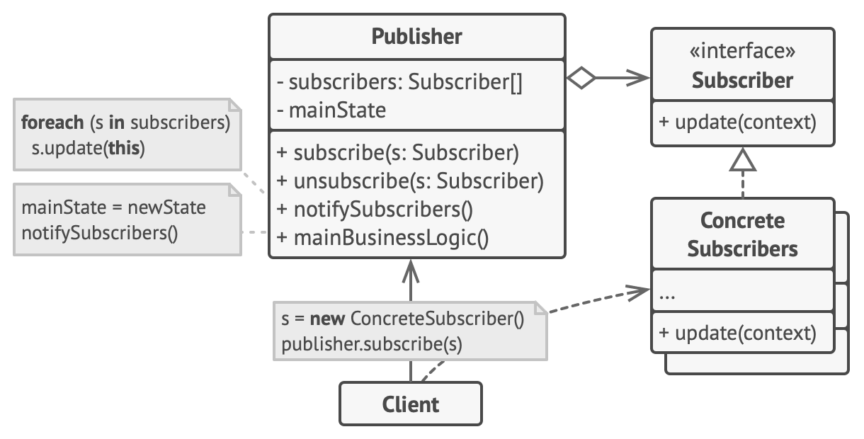
Structure
Notes:
The Publisher issues events of interest to other objects. These events occur when the publisher changes its state or executes some behaviors. Publishers contain a subscription infrastructure that lets new subscribers join and current subscribers leave the list.
When a new event happens, the publisher goes over the subscription list and calls the notification method declared in the subscriber interface on each subscriber object.
The Subscriber interface declares the notification interface. In most cases, it consists of a single update method. The method may have several parameters that let the publisher pass some event details along with the update.
Concrete Subscribers perform some actions in response to notifications issued by the publisher. All of these classes must implement the same interface so the publisher isn’t coupled to concrete classes.
Usually, subscribers need some contextual information to handle the update correctly. For this reason, publishers often pass some context data as arguments of the notification method. The publisher can pass itself as an argument, letting subscriber fetch any required data directly.
The Client creates publisher and subscriber objects separately and then registers subscribers for publisher updates.

Slide 26
Step-by-step instructions
Separate Business Logic
Identify core functionality → Acts as the Publisher
Identify dependent components → Act as Subscribers
Define Interfaces
Subscriber Interface → Declares update() method
Publisher Interface → Methods to add/remove subscribers
Manage Subscriptions
Store subscriber list in an abstract class (for reusability)
Alternative: Use composition to separate subscription logic
Implement Concrete Classes
Publisher: Notifies all subscribers when an event occurs
Subscriber: Implements update() method to react to changes
Register Subscribers: Clients create subscribers and attach them to publishers

Slide 27
05
CONCLUSION

Slide 28
Conclusion
Design Patterns provide reusable solutions to common software design problems, improving code structure and maintainability.
Singleton ensures a class has only one instance and provides global access, useful for managing shared resources.
Adapter acts as a bridge between incompatible interfaces, enabling seamless integration of different systems.
Observer establishes a publisher-subscriber model for dynamic event handling without tight coupling.

Slide 29
References
[1] Alexander Shvets (2018). Dive Into Design Patterns.

Slide 30
Thank you for your attention!
https://www.cse.hcmut.edu.vn

